Slide 1
SMART LANDSLIDE MONITORING SYSTEM

Slide 2
PROBLEM
Unexpected landslides cause loss of life and property
This also results in huge traffic jams on NH.
Traffic jams cause delay in arrival of emergency services.

Slide 3
ALREADY EXISTING TECHNIQUES
World is working on to either prevent or reduce the damage of such calamities
No appropriate solution for prediction and detection
USGS (United States Geological Survey) has operated near real-time hillslope hydrologic monitoring stations

Slide 4
LANDSLIDE MONITORING
PRE
Observing moisture in soil
Observing the vibration in rocks
POST
Detecting the falling of rocks
Determining the mountain area

Slide 5
IDEATION
Predicting the probability of a landslide.
Immediately detecting the landslides.
Sending alerts to traffic police and PWD.
Instantaneous arrival of emergency services.

Slide 6
SOLUTION
Using a soil moisture sensor to sense soil loosening.
Using an accelerometer to sense the motion of rocks.
Using an ultrasonic sensor to detect a landslide.
Using a GSM module to send SMS alerts.

Slide 7
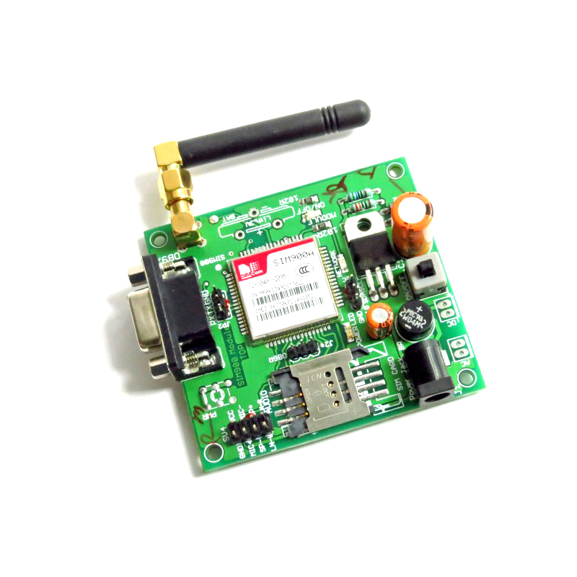
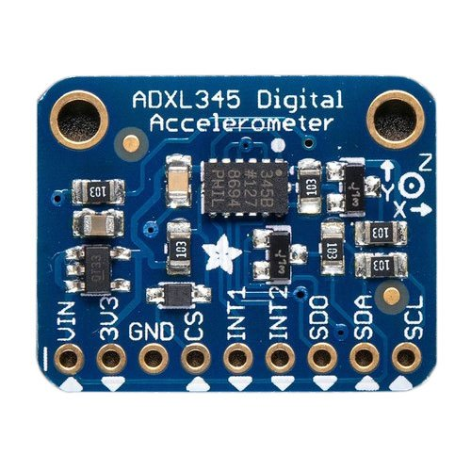
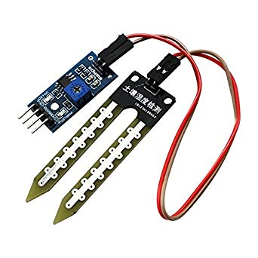

Accelerometer
GSM Module
Ultrasonic Sensor
Moisture Sensor
Arduino

Slide 8

Accelerometer
Accelerometer
Moisture Sensor

Slide 9

Ultrasonic Sensor

Slide 10

Emergency:-
Wakna003
Landslide ahead.
GSM Module

Slide 11
IMPLEMENTATION FEASIBILITY
Small modules can be made using industrial grade components
Those modules can be installed in the landslide prone areas at the hotspots
GSM module can be connected to the nearest police post

Slide 12
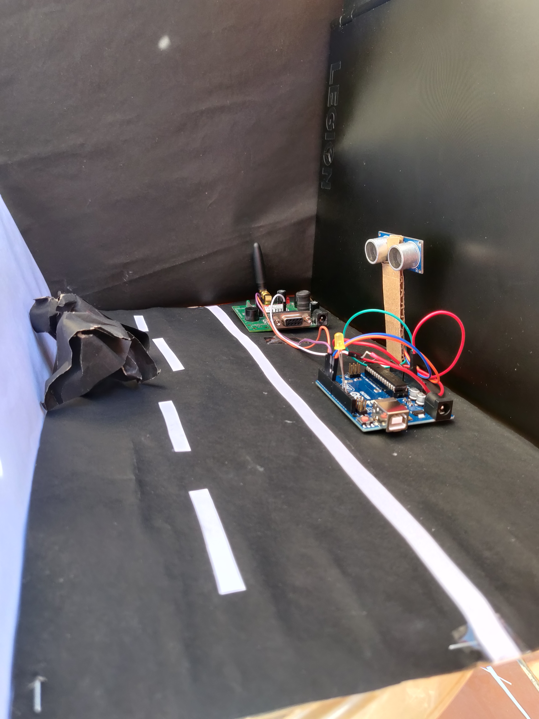
Prototype Model

Slide 13
THANK YOU

